Slide 1
The title of your interesting research goes here
Your name goes here
Kognitive and Integrative Systems Neuroscience, M.Sc.
Last updated on the 25th of September 2024
Notes:
My suggestion

Slide 2
Outline
The outline of your presentation helps us to easily identify topics or things of interest. However, it is up to you if you would like to use an outline or not. It is down to personal style and preference.

Slide 3
Introduction
Literature review – tell us about what is known out there about the topic in question and what is not known (research gap). This step can help to better generate specific questions and hypotheses. Link information, introduce important terms. Use images if you think they will help you to better visualize the topic. Remember, you are telling a story, use references examples, images, key words, etc.

Slide 4
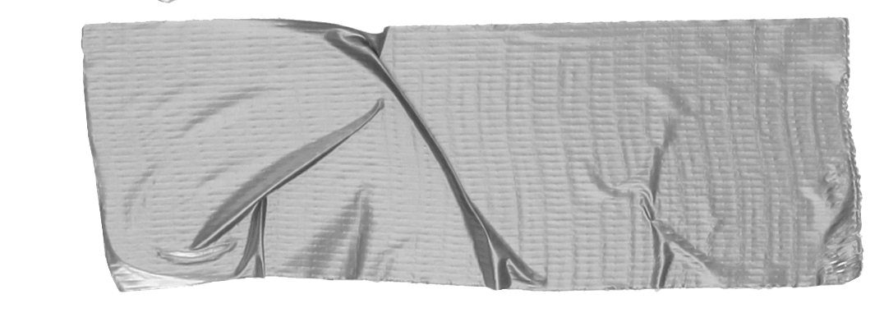
Questions and Hypotheses
What, Why, Where? Be as specific as possible!
H1 – behavioral exp. icon we expect an increase in X if …
H2 – MRI icon How activity in FFA and STS changes…
Hn – modeling Icon Feel free to use this icons.

Slide 5
Methods – what is my plan?
Work package 1:
….
Work package 2:
…
_________________
What are you going to use? And how are you planning to answer your question?
What neuroimaging techniques are you going to employ?
What statistical analyses are you planning to conduct?
When are you planning to finish each WP?

Slide 6
Methods – what is my plan?
Number and features of subjects/participants that you would use. (even better if you have a power analysis to justify the no. of participants selected)
Experimental design…

Slide 7
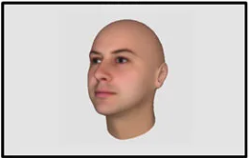
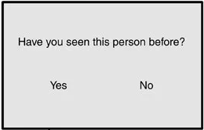
Methods – Stimuli – E.P.
N = 15
TR = 3 s
a
b
750ms
1,000ms
Varied onset over the first two scans of the trial
Varied onset over the third and fourth scans of the trial
TR1
TR2
TR3
TR4
Face recognition task
Notes:
E.P. = experimental paradigm.
The image above is an example of an experimental paradigm

Slide 8
Methods – how it ended up
Be as precise as possible. For example…
… name software used and the version
… provide links to stimuli databases
… how many subjects were recruited? How many were excluded (incl. exact sub-IDs) and why?
…

Slide 9
Results

Slide 10
Results

Slide 11
So, Star wars
If they destroy me any chance of saving her will be lost
Discussion
It is traeason then….
If what you told me is true, you would have gained my trust young padawan

Slide 12
Limitations
Name limitations of your study
E.g. concerning the experimental design, methods used, subject selection, power etc.

Slide 13
Summary
Unlimited power!

Slide 14
Outlook
Fullfill your destiny young skywalker

Slide 15
References
Literature…

Slide 16
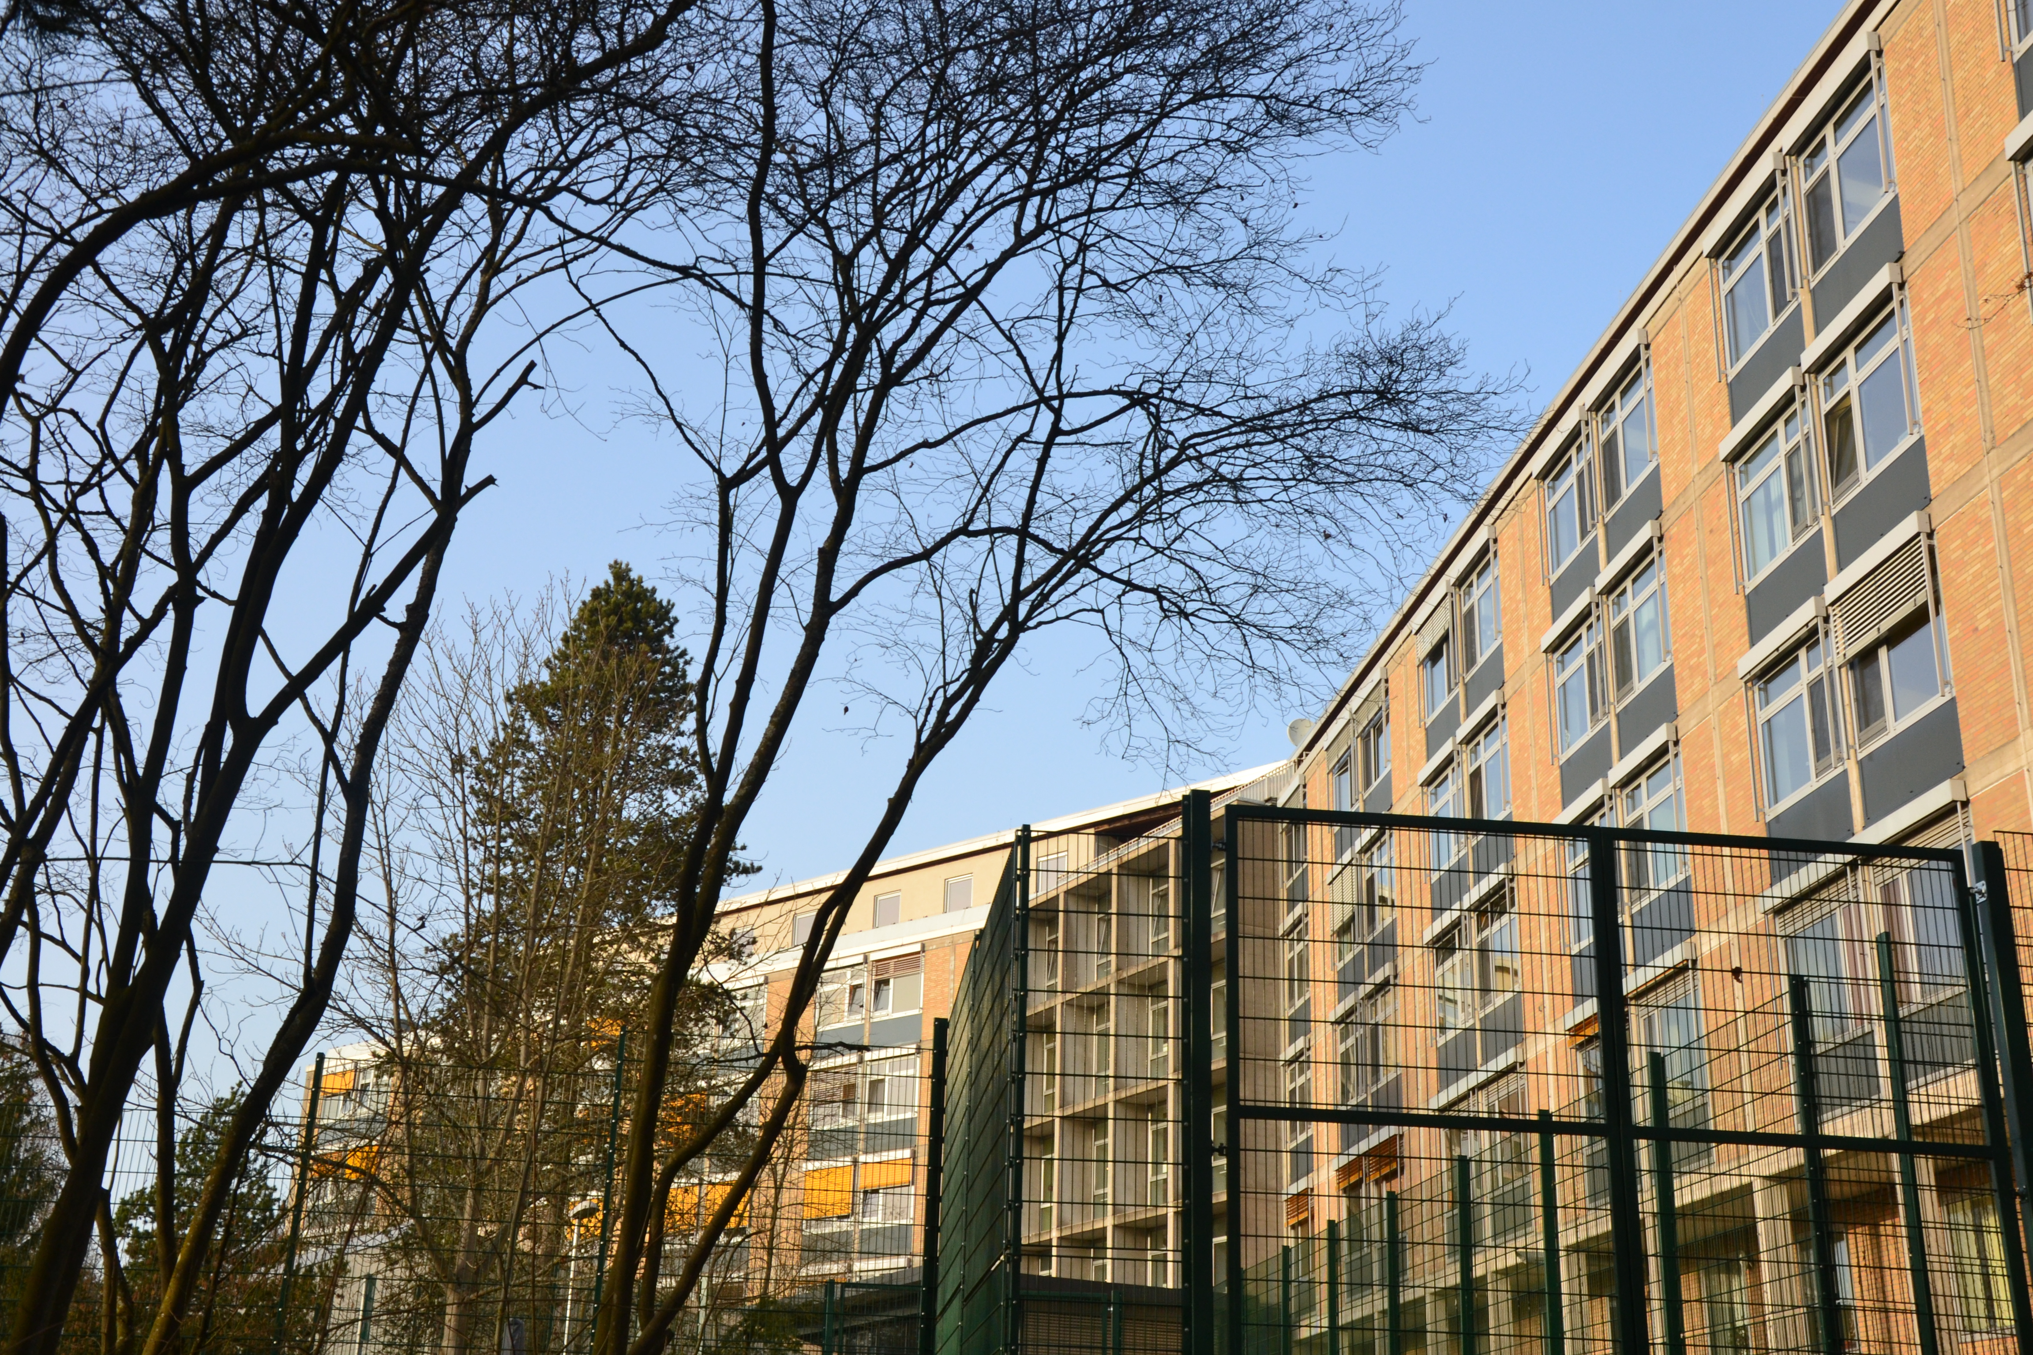
Thanks for your attention
@LMN_marburg

Slide 17
Where is the data?
1. Provide a link to the digital Project folder,
2. Physical Project folder
Where is the folder with the signed “Probandeninformation”, what additional material can be found in this folder. For example, questionnaires etc.
All projects should be organised according to the
GIN-Tonic research folder structure (https://gin-tonic.netlify.app/standard/)
The subfolder “03_data/”
should be structured according to BIDS https://bids.neuroimaging.io/

Slide 18
Feel free to make use of space, colors and shapes as you like! See some examples in next slides
Computational model
F_{(t)} = V_{(i)}⨯ C_{(t)}
F_{(t)} = Overarching familiarity
V_{(i)}= View independent familiarity
C_{(t)}= Contextual familiarity
Notes:
I would prefer to go with one design and not too many variations in one presentation. Therefore I moved thes optional design ideas to the end of the presentation.

Slide 19
Results

Slide 20
So, Star wars
If they destroy me any chance of saving her will be lost
Discussion
It is traeason then….
If what youtold me it is true, you would have gain my trust young padawan
Notes:
The quote in the lower right corner doesn‘t seem to be quite correct.

Slide 21
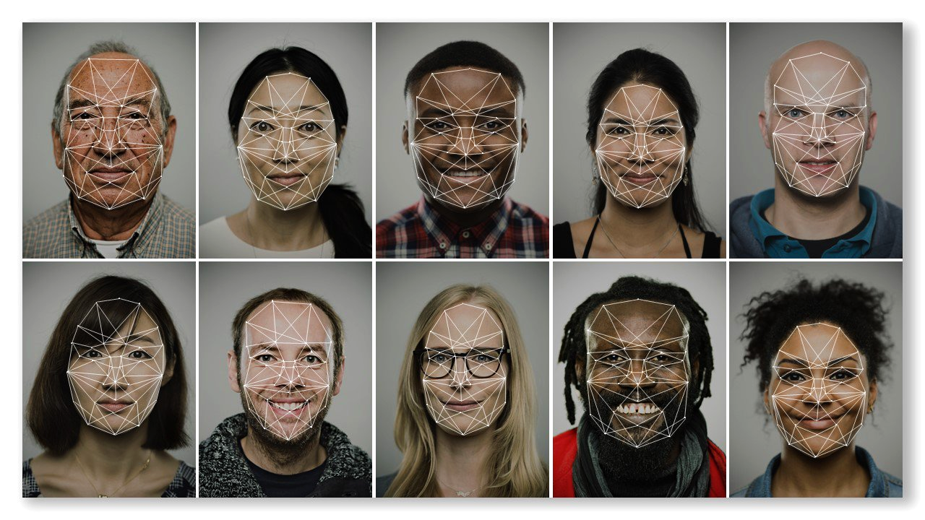
Conclusions. Unlimited power!!!
I

Slide 22
Outlook:
Fullfill your destiny young skywalker

